Slide 1
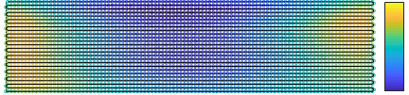
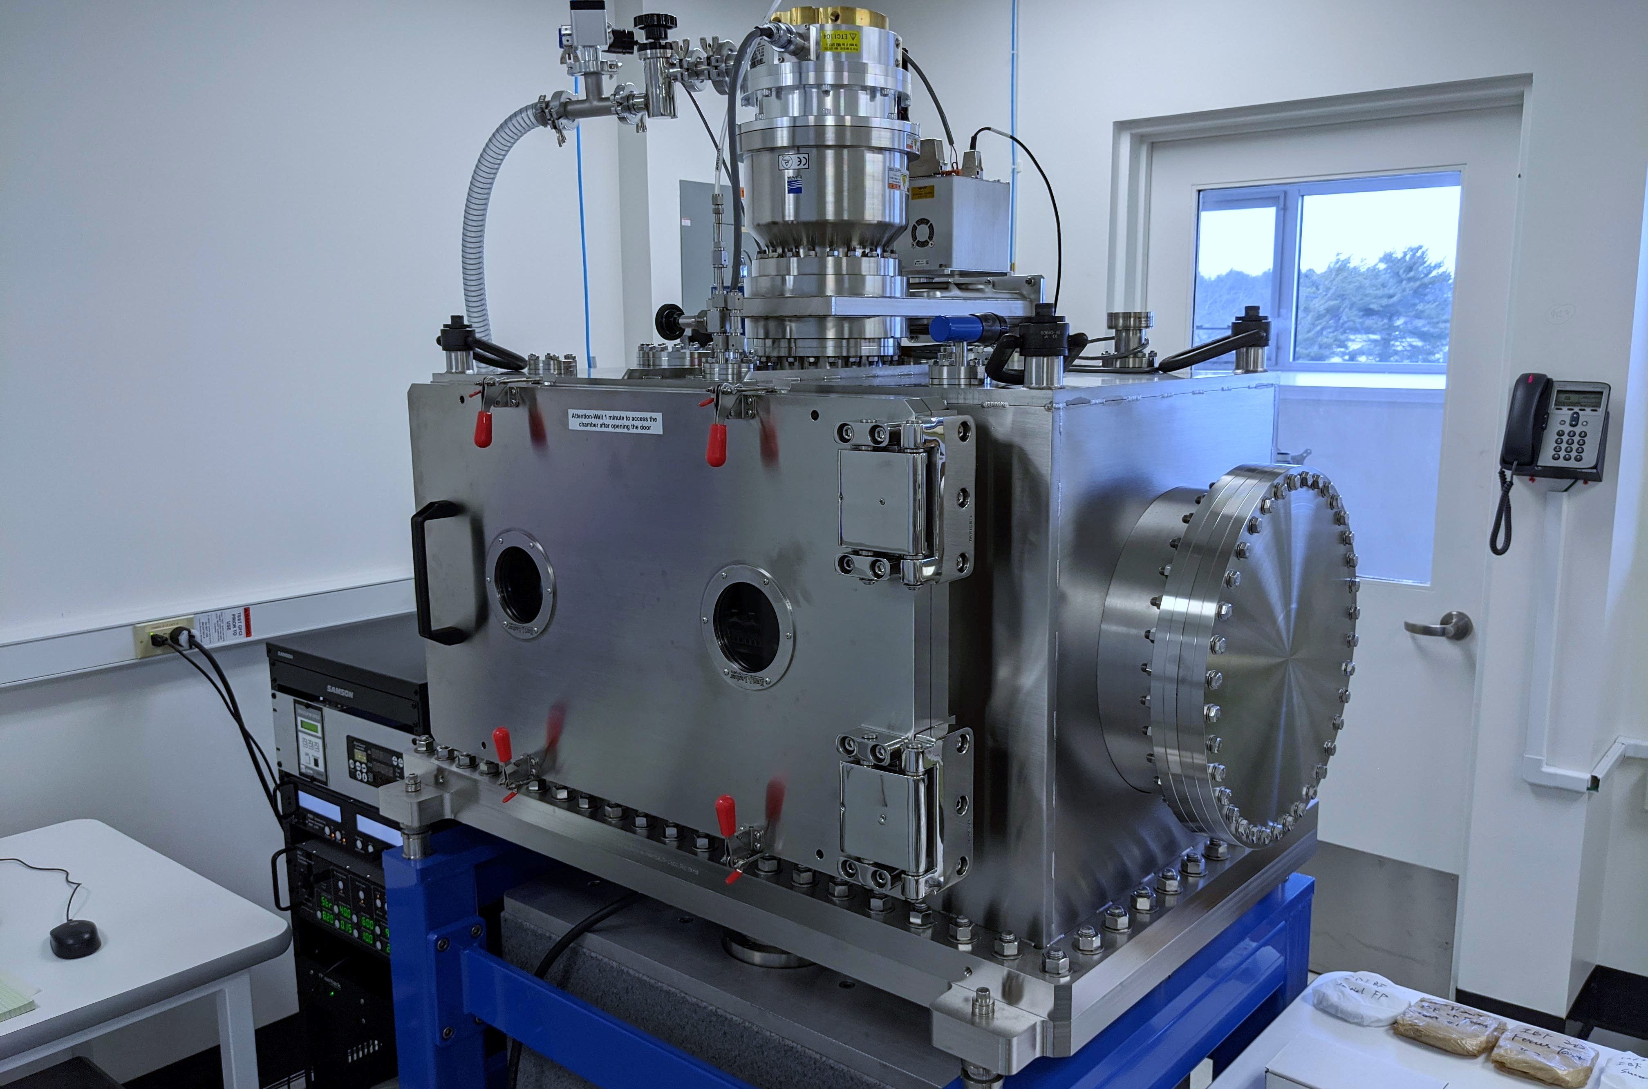
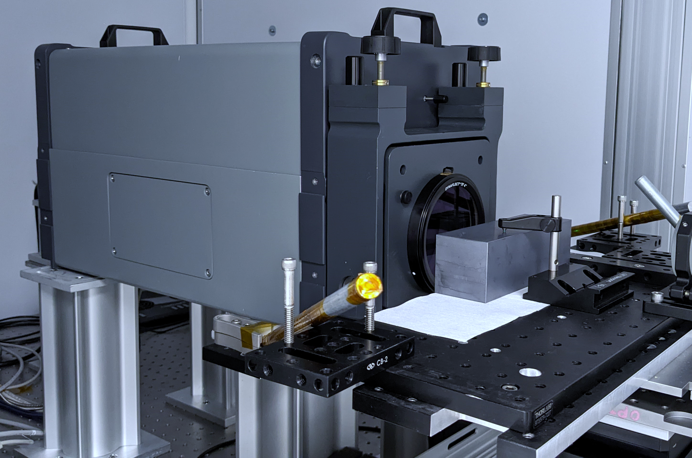
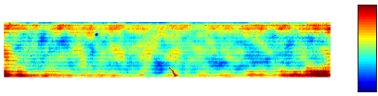
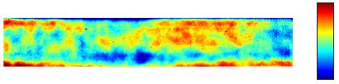
(a) Scheduling and simulation
(b) Fabrication and metrology
Raster path, total dwell time = 8.15 min
IBF system
Stitching interferometry
[ s ]
0.3
26 mm
0.1
102 mm
[ nm ]
[ nm ]
Raster path, simulated residual RMS = 0.20 nm
0.5
Raster path, measured residual RMS = 0.19 nm
0.5
16 mm
16 mm
92 mm
92 mm
-0.5
-0.5

